Slide 1
IBM data science professional certificate- Capstone
The battle of neighbordhood (Toronto)
Best Apartment rental in Airbnb (with baby considerations)

Slide 2
Problem to be resolved:
Find a rental unit subject to the following conditions:
An entire home/apartment with monthly rent not to exceed $150/night
Medium Availability (100days/year)
Unit located within walking distance (<=1.0 mile, 1.6 km) from a subway metro station in Toronto
Area with ammenities and venues mentioned earlier (at least one venue of each category ) within walking distance (<=1.0 mile, 1.6 km)

Slide 3
Data Sources:
• The list of Toronto neighborhoods
• A list of Toronto subway metro
• A list of places for short term rent from Airbnb.com

Slide 4
Methodology Section:
Processing(extracting raw table from webpage)
Processing (Extracting Latitude and Longtitude for each Postal code in Toronto)
Create a Map of Toronto (11 Boroughs and 103 neighbourhoods)
Find the 10 most common venues around each neighbourhood

Slide 5
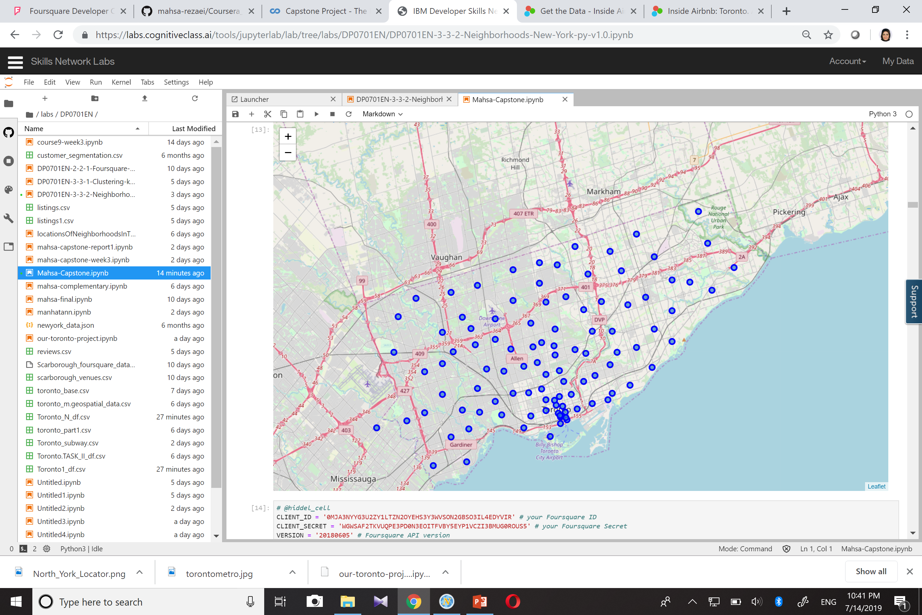
Toronto and its borough and Neighbourhoods

Slide 6
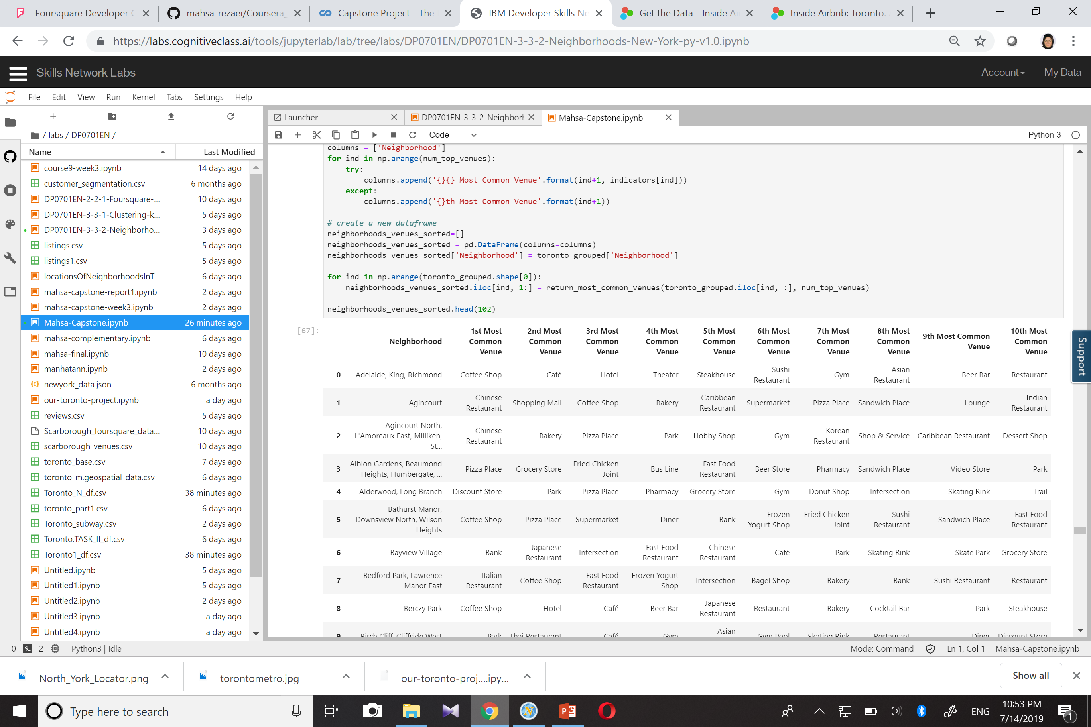
10 most common venues around each neighbourhood

Slide 7
‘York Mills” Neighbourhood is selected as it meets most of the considerations and needs.
“York Mills” is located in “North York” borough

Slide 8
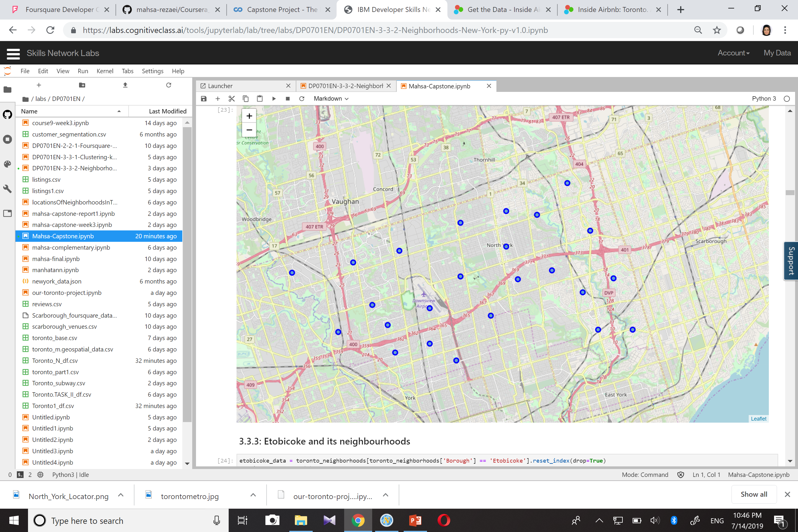
North York and its neighbourhoods

Slide 9
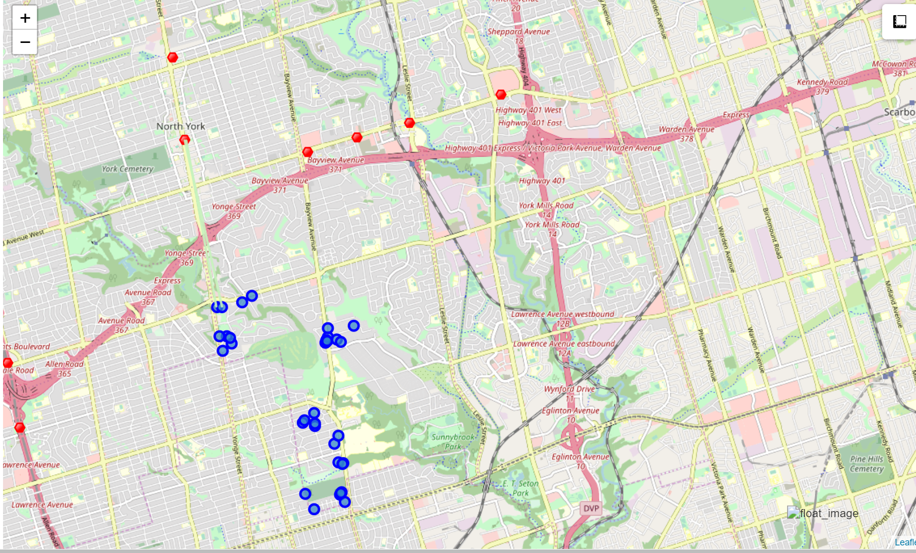
Airbnb listing in York mills+subway stations around the neighbourhood

Slide 10
Result
the apartment rental listing above which is shown in the map, meets all the considerations we needed. Just we need to find the nearest listing to a subway station.
The nearest among all are the ones mentioned in the following:
Entire home/apartment with $ 400 per night's price and a distance of 2.872 km from the North york station
private room with $ 119 per night and a distance of 2.897 km from Yorkdale station
Based on the above results, the first case best fulfills our needs.

